Slide 2
Magnetic Cores designs with FEMM
Simulating magnetic core using FEMM and LUA scripts to estimate inductance and Magnetic Gain
Javier Contreras
Scott Vestal
February 2017

Slide 3
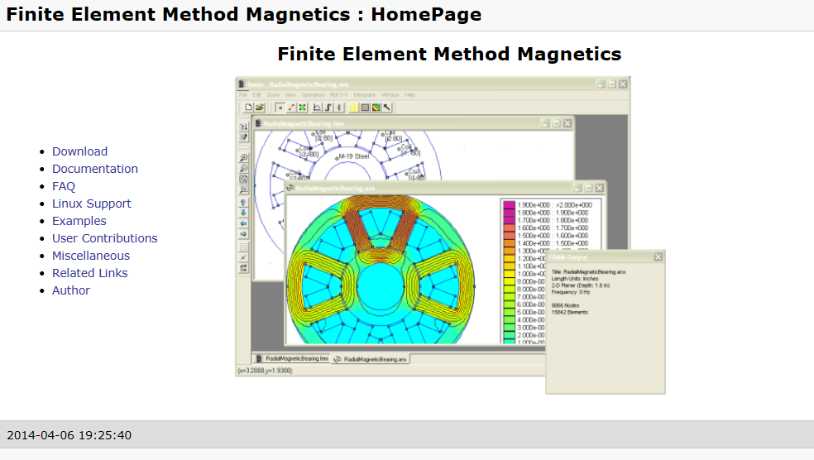
Installing FEMM
FEMM can be downloaded from the official website. http://www.femm.info/wiki/HomePage.

Slide 4
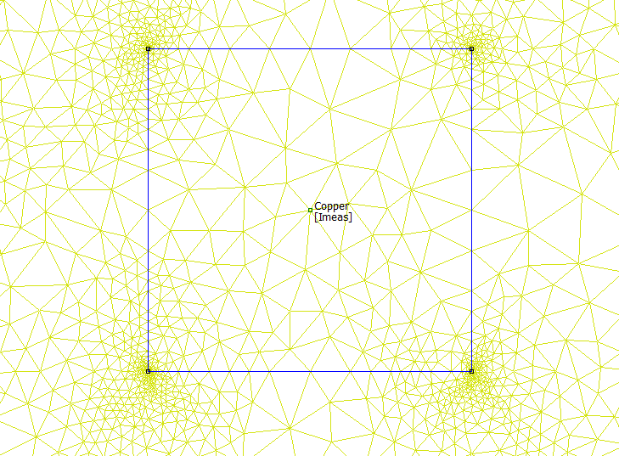
Finite Element Method Magnetics (FEMM) Basics
FEMM uses a Finite Element method to solve electromagnetics problems.
Nodes connected by line segments and arcs to define boundary conditions as well as regions containing different materials and current distributions.
FEMM then generates a mesh within this problem’s geometry, which it uses to solve for the magnetic field distribution within the boundaries.

Slide 5
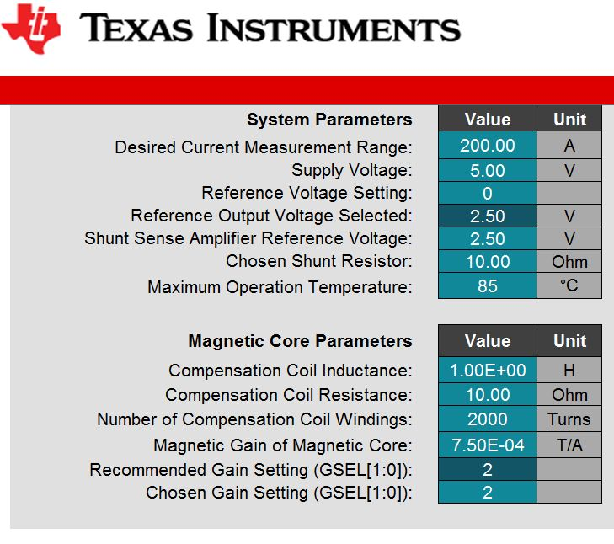
Finite Element Method Magnetics (FEMM) Basics
LUA allows all the functionality of FEMM to be controlled through scripting and make drawing a core and changing parameters quicker and not having to redraw a core in FEMM
Scripts attached are used to get an estimate of magnetic core’s inductance in the secondary coil and the core’s magnetic gain.
Parameters are used in the DRV421 System Parameter Calculator

Slide 6
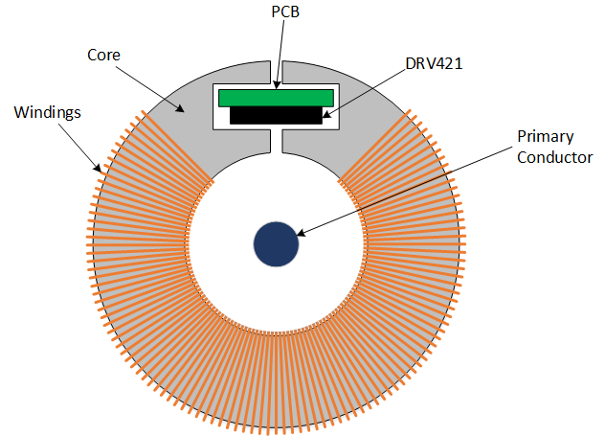
Magnetic Core
The script attached will draw the core seen.
Download script and save where you would like all your FEMM Magnetic Core simulations saved.

Slide 7
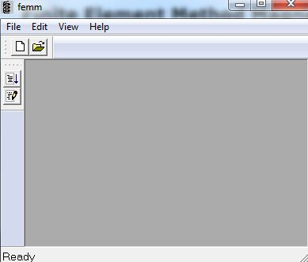
Run Script From FEMM
Click “Open a Lua Script”
Navigate to location of the scipt “Build_Magnetic_Core.lua” and select it.
Follow the next slides for description of the input parameters.

Slide 8
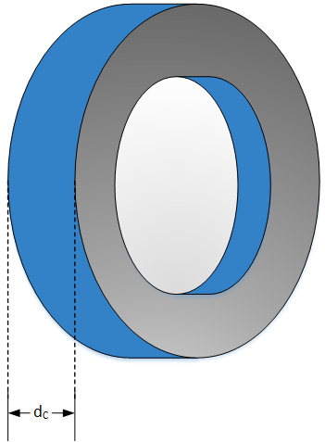


Input Parameters for Script
File Name – This is the name of the file created and saved. It will be save in the folder that contains the script.
Note: file name must include .fem extension
Core_Depth (d_{c}) This is how much depth in the simulation there is. This is the axis that is not shown in FEMM since this is only a 2D drawing.

Slide 9
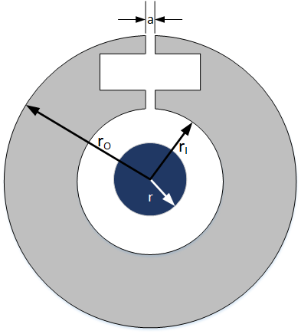



Input Parameters for Script Cont.
Core Inside Radius (r_{i})
Core Outer Radius (r_{o})
Air Gap (a)

Slide 10


Input Parameters for Script Cont.
Primary Radius (r)
Core Permeability
14000 (Iron)
83000 (Mu Metal)

Slide 11
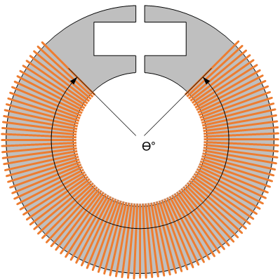


Input Parameters for Script Cont.
Number of Turns- Secondary Coil number of windings.
Winding Angle (Ɵ°)

Slide 12
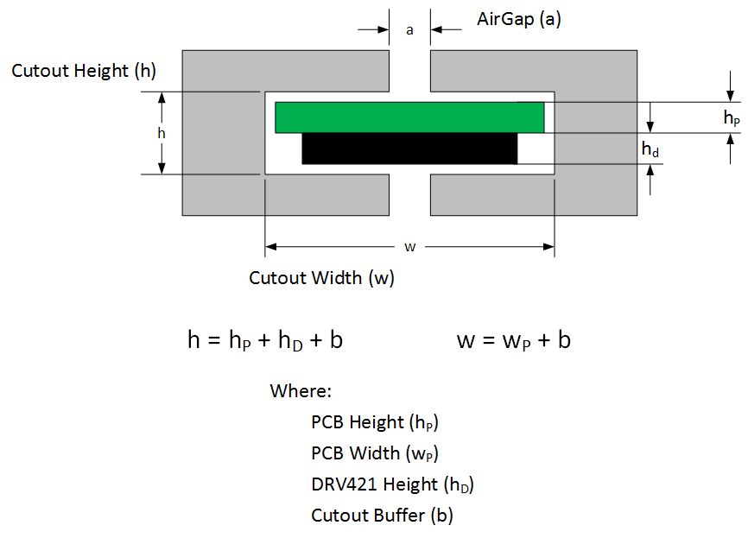



Input Parameters for Script Cont.
PCB Height (h_{P})
PCB Width (w_{P})
Cutout Buffer (b)
DRV421 Height (h_{D}) is a constant

Slide 13
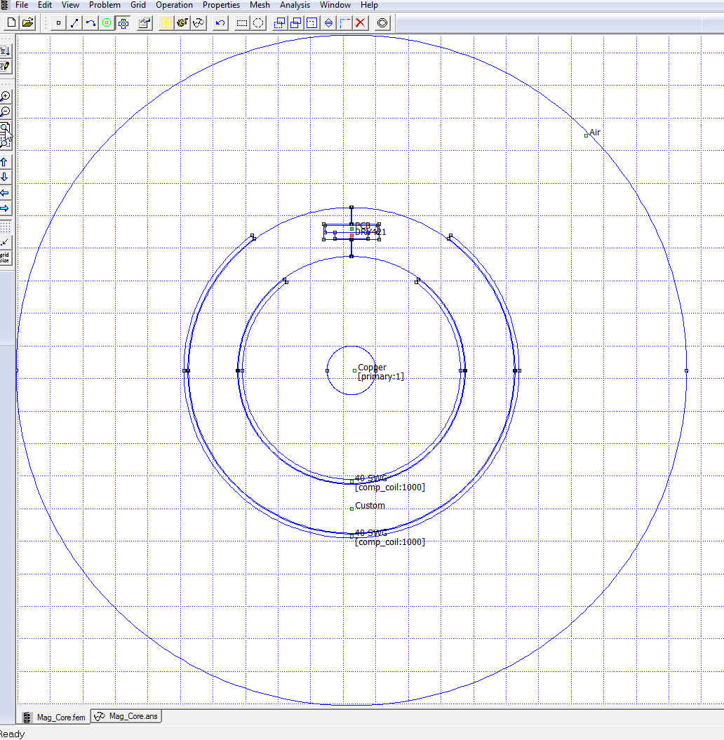
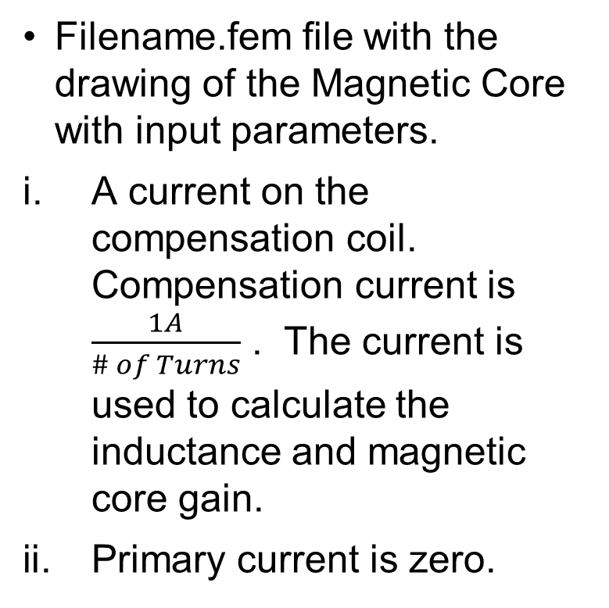
Script outputs
Filename.fem file with the drawing of the Magnetic Core with input parameters.
A current on the compensation coil. Compensation current is $\frac{1A}{\# of Turns}$ . The current is used to calculate the inductance and magnetic core gain.
Primary current is zero.

Slide 14
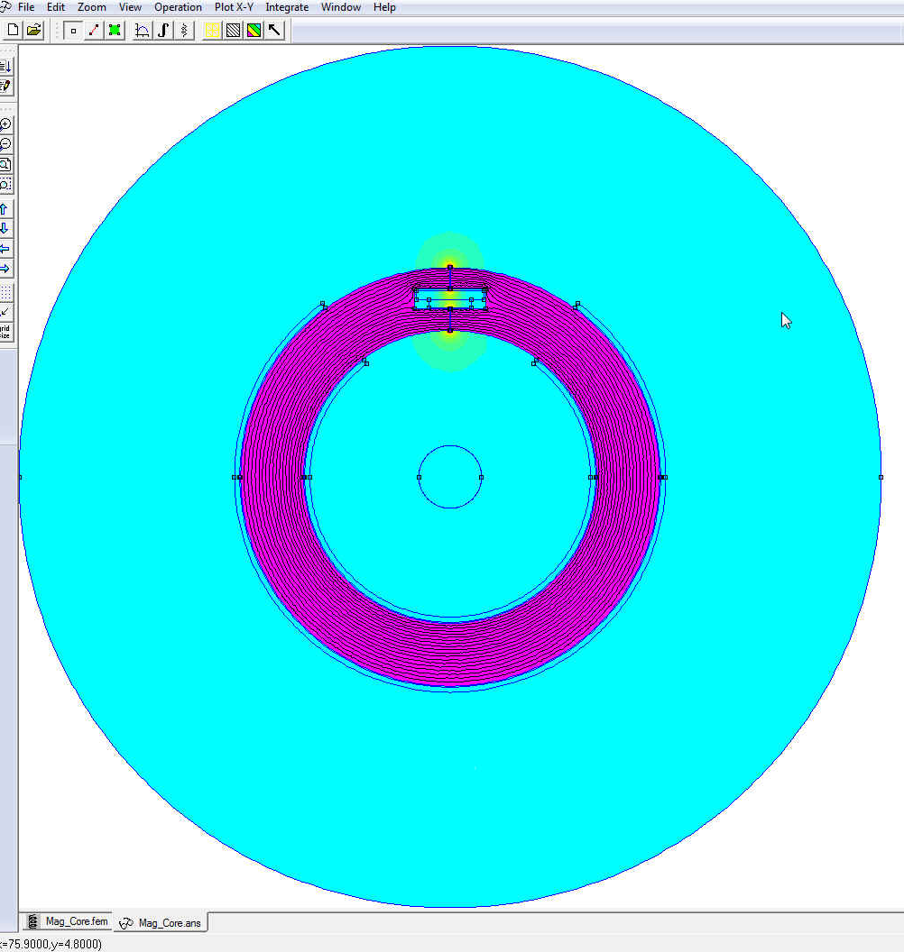
Script outputs Cont.
Filename.ans (answer) file that shows the magnetic field on and surrounding the magnetic core with current on the compensation coil as described in previous slide.

Slide 15
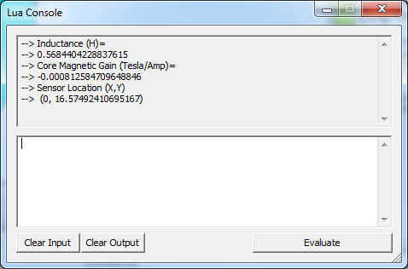
Script outputs Cont.
Lua Outputs.
Inductance(H)
Core Magnetic Gain (Tesla/Amp)
Sensor Location (X,Y) 0.4 mm from top of DRV421

